Slide 1
Algorithms For (Sub)Graph Matching
QiuWentao

Slide 2
Content
VF2
AGM- Apriori Based
FSG
gSpan

Slide 3
VF2 A (Sub)Graph Isomorphism Algorithm for Matching Large Graphs

Slide 4
Basic Information
Title: A (Sub)Graph Isomorphism Algorithm for Matching Large Graphs
Authors: Luigi P. Cordella, Pasquale Foggia, Carlo Sansone, and Mario Vento
Affiliation: Dipartimento di Informatica e Sistemistica, Universita´ di Napoli \Federico II\ (Luigi P. Cordella)
Keywords: Graph-subgraph isomorphism, large graphs, attributed relational graphs.

Slide 5
Research Background
This paper proposes a graph isomorphism and subgraph isomorphism algorithm that is efficient when dealing with large graphs.
The algorithm is a deterministic matching method suitable for verifying isomorphism and subgraph isomorphism and has general effectiveness because there are no constraints imposed on the topologies of the graphs.
The algorithm uses a state space representation (SSR) of the matching process and a set of five feasibility rules to prune the search tree.
The feasibility rules eliminate the generation of inconsistent states that do not lead to complete solutions and reduce the search space.
The algorithm has been tested on a publicly available synthetic graph database and attributed graphs obtained from actual applications in the technical drawing field.
The results confirm the effectiveness of the method, especially when dealing with large graphs. The algorithm outperforms the Ullmann algorithm in matching time and is suitable for matching graphs with thousands of nodes and branches.
The algorithm is an improvement over the VF algorithm (a preliminary version of the algorithm) as it reduces memory requirements.

Slide 6
Past Methods
Their Problems and Motivations:
Past methods were inefficient when dealing with large graphs and mostly constrained the topologies of the graphs.
To accomplish more efficient matching, this paper proposes an improved algorithm that follows feasibility rules to optimize performance in different applications.

Slide 7
Research Method Proposed
This paper proposes a graph matching algorithm that uses feasibility functions to explore the search graph.
The feasibility function depends on two sub-functions: Fsyn for checking syntactic feasibility and Fsem for checking semantic feasibility.
The algorithm uses a depth-first search strategy to explore the search graph and includes a special process to avoid the generation of visited states.
The candidate matching set P(s) is calculated by considering the set of nodes directly connected to G1(s) and G2(s), and feasibility rules Rpred, Rsucc, Rin, Rout, and Rnew are introduced for consistency checks and pruning the search tree.
Several implementation issues, data structures, and a cost function to quantitatively evaluate dissimilarity between two nodes or branches are discussed in the paper.
The algorithm is designed to efficiently handle large graphs, and its search space is reduced by pruning states that have costs greater than the best target state reached so far.

Slide 8
Tasks and Performance of the Method
The proposed algorithm is designed for efficient matching of large graphs and can handle isomorphism and graph-subgraph isomorphism without making special assumptions.
The experimental results show that the algorithm performs better than the Ullmann algorithm in matching subgraphs with over 20 nodes, with the time reaching up to four orders of magnitude for subgraphs with over 100 nodes.
The paper concludes that the algorithm presents a particularly interesting achievement, as almost all algorithms proposed so far cannot simultaneously meet all necessary requirements.

Slide 9
Background
a. Theme and Characteristics:
The theme of this paper is the matching problem of large graphs, and an improved algorithm is proposed.
b. Historical Development:
Past graph matching algorithms were inefficient when dealing with large graphs.
c. Past Methods:
Past methods usually constrained the topologies of the graphs.
d. Deficiencies in Past Research:
Past algorithms were inefficient when dealing with large graphs.
e. Current Problems to be Solved:
How to improve the efficiency of matching large graphs and overcome limitations related to the topologies of the graphs?

Slide 10
Method
a. Theoretical Foundation of the Research:
This paper uses a state space representation of the matching process and a set of feasibility rules.
b. Technical Approach of this Paper (Step by Step):
This paper proposes a matching algorithm that uses feasibility functions to explore the search graph.
The algorithm uses a depth-first search and includes a special process to avoid the generation of visited states.
The algorithm calculates the candidate matching set P(s).
Feasibility rules Rpred, Rsucc, Rin, Rout, and Rnew are introduced for consistency checks and pruning the search tree.
A cost function is used to quantitatively evaluate dissimilarity between two nodes or branches.

Slide 11
Conclusion
a. Importance of the Work:
The proposed algorithm can match large graphs more efficiently and overcomes limitations of past algorithms.
b. Innovation, Performance, and Burden:
The algorithm outperforms the Ullmann algorithm in matching time and is suitable for matching graphs with thousands of nodes and branches while reducing memory requirements.
c. Research Conclusion (List of Key Points):
This paper proposes a graph matching algorithm that uses feasibility functions to explore the search graph.
Feasibility rules Rpred, Rsucc, Rin, Rout, and Rnew are introduced for consistency checks and pruning the search tree.
Matching time can be further reduced by considering information held in the attribute and semantic parts when dealing with attributed relational graphs.
The experimental results show that the algorithm performs better than the Ullmann algorithm in matching subgraphs with over 20 nodes, particularly for subgraphs with over 100 nodes.

Slide 12
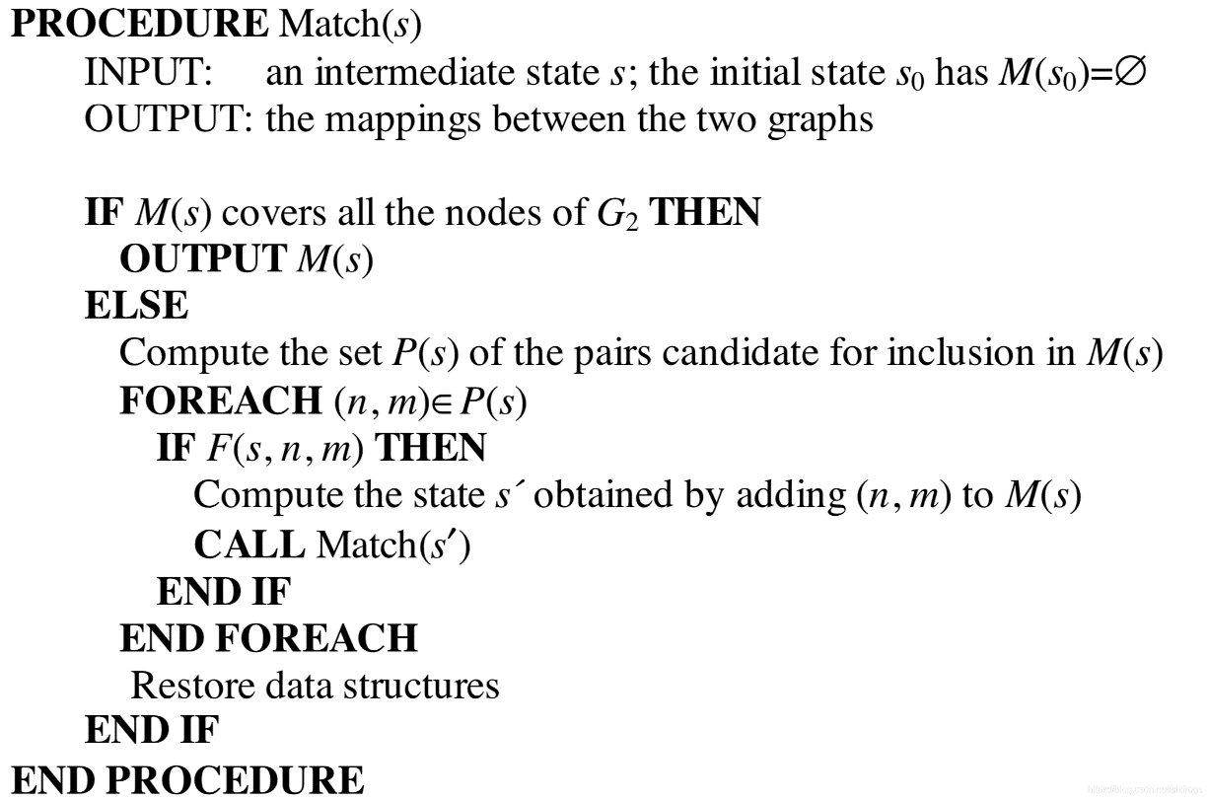

Procedure
$F(s,n,m)$is a boolean function, also known as the feasibility function.
If the return value of the function is true, it means that adding the edge (n,m) to the current state s (where s represents the current partial mapping $M(s)$that satisfies the isomorphism) results in a new state s* whose partial mapping $M(s∗)$still satisfies the isomorphism.
Therefore, the final state may be isomorphic to G1 or G2, or be a subgraph isomorphic to either of the graphs. If the return value is false, it means that the edge (n,m) should not be added to the current state and can be used for pruning.

Slide 13


Definition of P(s)
Given a graph G and a vertex n, we define Pred(G,n) as the set of in-neighbors of n (i.e., its predecessors) and Succ(G,n) as the set of out-neighbors of n (i.e., its successors).
The out-terminal set $T1_{out\left(s\right)}$for G1 as the set of successors of nodes in M1(s) that are not in M1(s) and the in-terminal set $T1_{in\left(s\right)}$ as the set of predecessors of nodes in M1(s) that are not in M1(s). Similarly, we define $T2_{out\left(s\right)}$and $T2_{in\left(s\right)}$for G2.
P(s) is constructed as follows: (1) If both $T1_{out\left(s\right)}$and $T2_{out\left(s\right)}$are non-empty, then P(s) = $T1_{out\left(s\right)}× \left\{\min{T2_{out\left(s\right)}}\right\}$, where min $T2_{out\left(s\right)}$is the node in $T2_{out\left(s\right)}$with the smallest label (using any sorting method).
(2) If both $T1_{out\left(s\right)}$and $T2_{out\left(s\right)}$are empty and both $T1_{in\left(s\right)}$and $T2_{in\left(s\right)}$are non-empty, then $P\left(s\right)= T1_{in\left(s\right)}× \left\{\min{T2_{in\left(s\right)}}\right\}.$
(3) If all four terminal sets are empty, then $P\left(s\right)= \left(V1 − M1\left(s\right)\right)× \left\{\min\left(V2 − M2\left(s\right)\right)\right\}$, where V1 and V2 are the sets of nodes in G1 and G2, respectively.
If there is only one in-terminal set or only one out-terminal set is empty, then the state s cannot lead to a final isomorphism, and thus, it does not need to be further analyzed. Moreover, the definition of P(s) ensures that the same state is not visited twice.

Slide 14

Definition of F(s,n,m):
To determine F(s,n,m), the algorithm checks all nodes connected to n and m.
1. For nodes in M1(s) and M2(s), the algorithm checks whether the in-neighbors and out-neighbors of these nodes in M1(s) and M2(s) are matched one-to-one with those of n and m, respectively.
2. For nodes not in M1(s) and M2(s), the algorithm calculates the number of nodes in the sets $Tin(s), Tout(s),$and $Vi − Mi(s) − Tin(s) − Tout(s)$.
3. For isomorphism, these sets for n and m must have the same size. For subgraph isomorphism, the sizes of these sets for the small graph must be less than or equal to those for the large graph.
4. If the graph has labels, F(s,n,m) also checks whether the node and edge labels are the same.

Slide 15


Implementation details:
Two vectors, $core_{1}$ and $core_{2}$(with dimensions equal to the number of nodes in G1 and G2, respectively), store the current mapping.
Specifically, if a node n is in M1(s), then $core_{1\left[n\right]}$stores the index of the node in G2 that corresponds to n. Otherwise, it stores $NULL_NODE$.
Four vectors, $in_{1}, out_{1}, in_{2}, and out_{2},$store the terminal sets. If a node n is in $M1\left(s\right)or T1_{in\left(s\right)},$then $in_{1\left[n\right]}$is non-zero, and its actual value is the depth of the state s in the SSR tree.

Slide 16
State Rpresentation
public class State { public int[] core_1; // stores for each target graph node to which query graph node it maps ("-1" indicates no mapping) public int[] core_2; // stores for each query graph node to which target graph node it maps ("-1" indicates no mapping) public int[] in_1; // stores for each target graph node the depth in the search tree at
which it entered "T_1 in" or the mapping ("-1" indicates that the node is not part of the set) public int[] in_2; // stores for each query graph node the depth in the search tree at
which it entered "T_2 in" or the mapping ("-1" indicates that the node is not part of the set) public int[] out_1; // stores for each target graph node the depth in the search tree at
which it entered "T_1 out" or the mapping ("-1" indicates that the node is not part of the set) public int[] out_2; // stores for each query graph node the depth in the search tree at w
hich it entered "T_2 out" or the mapping ("-1" indicates that the node is not part of the set) public HashSet<Integer> T1in; // nodes that not yet in the partial mapping, that are the destination of branches start from target graph public HashSet<Integer> T1out; // nodes that not yet in the partial mapping, that are the origin of branches end into target graph public HashSet<Integer> T2in; // nodes that not yet in the partial mapping, that are the destination of branches start from query graph public HashSet<Integer> T2out; // nodes that not yet in the partial mapping, that are the origin of branches end into query graph public HashSet<Integer> unmapped1; // unmapped nodes in target graph public HashSet<Integer> unmapped2; // unmapped nodes in query graph public int depth = 0; // current depth of the search tree public boolean matched = false; public Graph targetGraph; public Graph queryGraph;
.
.
.
.

Slide 17
CheckFeasibility
private Boolean checkFeasibility(State state , int targetNodeIndex , int queryNodeIndex) { // Node Label Rule // The two nodes must have the same label if (state.targetGraph.nodes.get(targetNodeIndex).label != state.queryGraph.nodes.get(queryNodeIndex).label){ return false; } // Predecessor Rule and Successor Rule if (!checkPredAndSucc(state, targetNodeIndex, queryNodeIndex)){ return false; } // In Rule and Out Rule if (!checkInAndOut(state, targetNodeIndex, queryNodeIndex)){ return false; } // New Rule if (!checkNew(state, targetNodeIndex, queryNodeIndex)){ return false; } return true; }

Slide 18
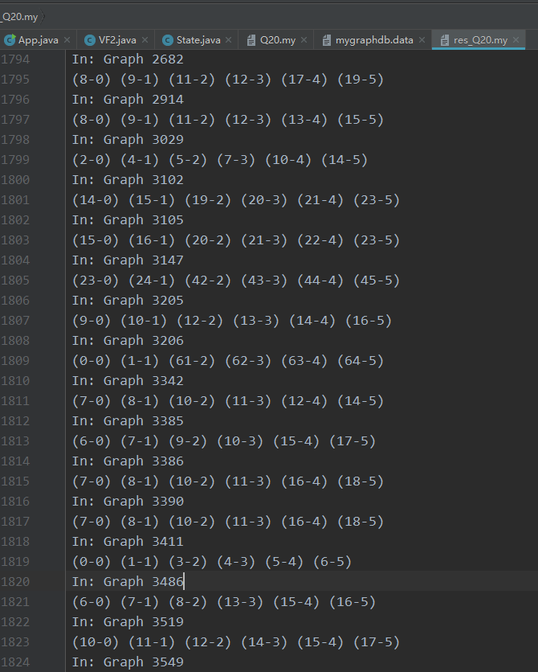
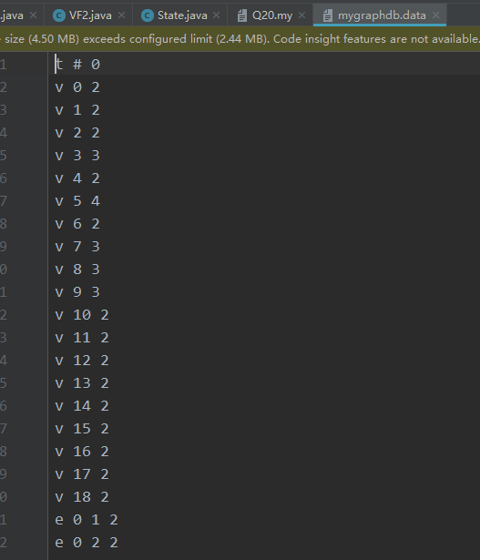
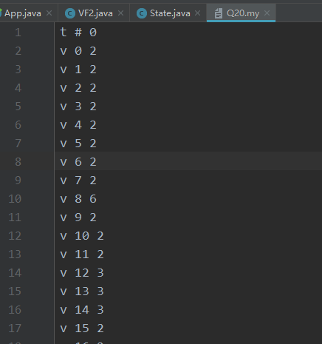
Test
Graph Data:
Query Graph Data:
Output:

Slide 19
AGM —Apriori Based An Apriori-Based Algorithm for Mining Frequent Substructures from Graph Data

Slide 20
Basic Information
Title: An Apriori-Based Algorithm for Mining Frequent Substructures from Graph Data
Authors: Akihiro Inokuchi, Takashi Washio, and Hiroshi Motoda
Affiliation: I.S.I.R., Osaka University
Keywords: graph data, frequent substructures, adjacency matrix, association rules, Apriori algorithm

Slide 21
Summary
a. Background:
This paper proposes a new approach, named Apriori-based graph mining (AGM), for effectively mining frequent substructures and association rules from graph structured data.
b. Previous approaches, problems, and motivation:
Previous approaches, such as adding support and confidence and performing graph-based inductive matrix transformation to generate inductive subgraphs, may miss important patterns due to their greedy search strategy, thus a new approach is needed.
c. Proposed approach in this paper:
The AGM approach combines the mathematical graph representation of the adjacency matrix with an extended Apriori algorithm for basket analysis.
d. Tasks and performance of the method implemented in this paper:
AGM was evaluated on artificially simulated data and cancer data from the University of Oxford and NTP, demonstrating its superior performance in solving practical problems.

Slide 22
Background
a. Topic and features:
This paper focuses on discovering frequent substructures and association rules from graph structured data using computational methods.
b. Historical development:
As more and more data is transformed into unstructured and semi-structured data, finding effective mining techniques becomes crucial. As research progresses, some graph-based algorithms have been proposed, such as subgraph mining and inductive algorithms.
c. Previous methods:
Previous methods include subgraph mining and SUBDUE, which may miss important patterns due to their greedy search strategy.
d. Deficiencies in previous research:
Previous methods are not efficient and cannot handle large structured data.
e. Current problems to be solved:
A new, more efficient algorithm must be found to handle large structured data, identify important patterns and association rules.

Slide 23
Method
a. The theoretical basis of this research:
The AGM approach combines the mathematical graph representation of the adjacency matrix with an extended Apriori algorithm for basket analysis to discover frequent inductive subgraphs in graph transactional data.
c. The innovation, performance, and workload of this approach compared to previous work:
Compared to previously developed techniques, the AGM approach is a novel alternative for discovering frequent structures and performs better in terms of performance.
This method has high efficiency in handling large structured data and can identify more important substructures that represent cancer

Slide 24
The technical roadmap (implemented step by step):
The algorithm generates inductive subgraphs through level-wise search using the concepts of support and confidence.
Then, the nodes in the adjacency matrix are sorted and the matrix is transformed into its normal form through matrix transformation.
As multiple normal forms generate equivalent inductive subgraphs, a canonical form is defined for these forms to calculate support.
Then, each normal form is indexed to its canonical form using previously known transformation matrices, allowing for efficient calculation of support.
The join process creates multiple Zk+1 for all possible value pairs and uses a bottom-up approach to transform non-normal form adjacency matrices into normal form.
The algorithm is confirmed to be effective when all subgraphs generated in the intermediate layer are in their normal form.
Normalization is constructed by permuting the rows and columns of the original matrix and is used to calculate the frequency of the subgraphs.

Slide 25
Innovation compared to previous work:
This method has high efficiency in handling large structured data and can identify more important substructures that represent cancer.
The AGM approach is a novel alternative for discovering frequent structures and performs better in terms of performance.

Slide 26
Conclusion
a. Significance of the research work:
The AGM approach is an effective technique for analyzing given graph datasets and can be used to mine frequent induced subgraphs and their association rules.
b. Innovation, performance, and workload:
The AGM approach has controllable and feasible computational complexity and exhibits strong performance in practical evaluations.
Through practical evaluations, AGM exhibits strong performance under specific conditions, becoming a valuable tool for analyzing real-world data.
c. Research conclusions (listed points):
AGM can discover more and more specific patterns in discriminating samples, making it important for finding key graph pattern information.
The AGM approach provides a more advanced data analysis tool for mining high-level substructures using a simple and effective algorithm than existing algorithms.
The application of AGM can draw reaction pathways and provide critical molecular information, helping to explain toxicity issues in human-made compounds.

Slide 27
FSG Efficient Algorithm for Discovering Frequent Subgraphs

Slide 28
Improvement on Apriori Method - FS-GRAF Algorithm
FSG is an improvement of the AGM algorithm. Like other Apriori-based methods, it uses a level-wise extension approach.
However, its optimizations include:
Using a relatively sparse graph representation to minimize storage space and computation costs.
Adding one edge at a time to expand the frequent subgraphs, making candidate set generation more efficient.
Using canonical labeling and graph isomorphism algorithms that are more effective for small graphs.
Optimizing candidate set generation and implementing various measures that can be applied to large-scale graph databases.

Slide 29
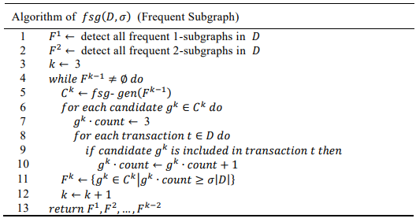
Algorithm for Frequent Subgraph
First, enumerate all frequent 1st- and 2nd-order subgraphs. Then, iterate over them as the source of the algorithm.
In each iteration, first generate candidate subgraphs with one more edge than the frequent subgraphs obtained in the previous iteration.
Then, calculate the frequency of each candidate subgraph, exclude those that do not meet the threshold, and add the subgraphs that meet the threshold to the frequent subgraph set.

Slide 30
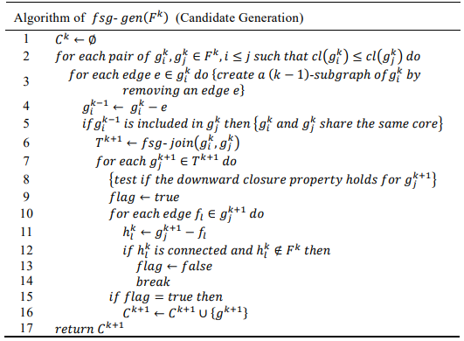

Algorithm for Candidate Generation
$D$: graph dataset
$t$: a graph data in the dataset
$k−subgraph$: a (sub)graph with k edges
$g_{k}$: k-order subgraph
$C_{k}$: candidate set with k edges
$F_{k}$: frequent subgraph with k edges
$fsg−gen\left(F_{k}\right)$: algorithm to generate candidate set $C_{k}$ for frequent subgraph$F_{k}$
Pseudocode for $fsg−gen$($F_{k}$):
1. Initialize an empty candidate set $C_{k}$.
2. For each frequent subgraph g in $F_{k}$, do:
a. For each vertex v in g, add all edges connecting v to vertices outside of g to form a set $E_{v}$.
b. For each pair of vertices u and v in g, add all edges between u and v to form a set $E_{uv}.$
c. For each edge e in $E_{v}or E_{uv}$, add g with e to $C_{k}.$
3. Return $C_{k}$.

Slide 31
gSpan

Slide 32

Forward Edge and Backward Edge
A forward edge is an edge that exists in the DFS tree.
A backward edge is an edge that does not exist in the DFS tree.
The nodes in the DFS tree are assigned values according to their order of generation by DFS subscripting, where $v0$is the root, and $vn(mostright vertex)$is the rightmost vertex.
The path from $v0$to $vn(mostright vertex)$ based on DFS subscripting is called the rightmost path.
Based on DFS subscripting, each edge can be represented as:
$（i, j）$, $i<j$ where is a forward edge . Conversely, $i>j$is a backward edge.
DFS

Slide 33
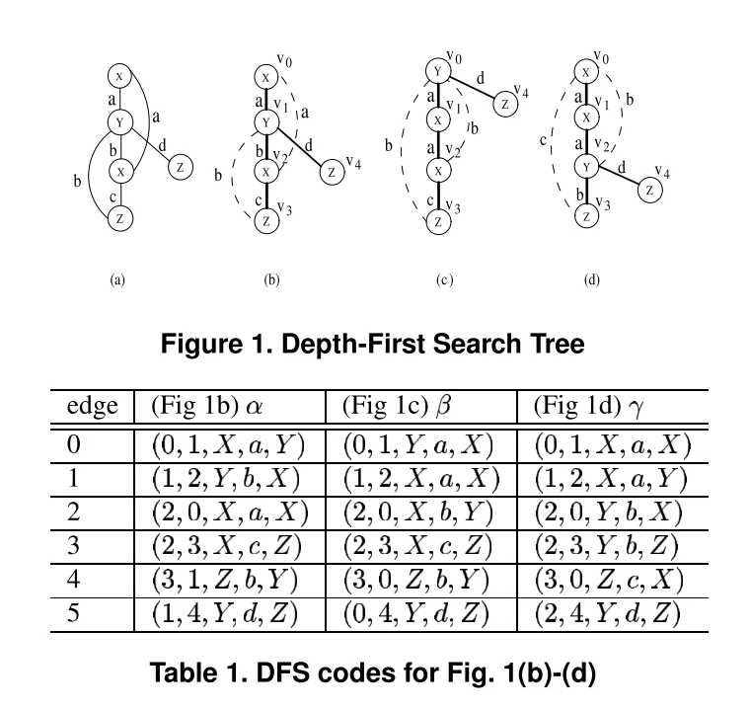

DFS Code
To convert an indexed graph into a sequence of edges using DFS Code, each edge (DFS Code) is represented using a 5-tuple. The 5-tuple format is as follows:
$$\left(i,j,li,l_{(i,j)},lj\right)$$
"DFS encoding not unique"

Slide 34
Minimum DFS Code
The minimum DFS code is the encoding sequence that has the smallest linear relationship in DFS lexicographic order.
Isomorphic subgraphs have the same minimum DFS code.
Therefore, finding isomorphic subgraphs of a graph can be transformed into finding the minimum DFS code.

Slide 35
DFS Code Tree
DFS Code Tree — A tree generated by DFS code
Each vertex corresponds to a DFS code, and the parent-child relationship follows the generation order of the rightmost path, while the sibling relationship follows the DFS lexicographic order.
The extension of forward edges can be performed on the rightmost path, while the extension of backward edges can only be performed from the rightmost node, and both follow the generation order of DFS lexicographic.
By traversing the DFS code tree, all minimum DFS codes can be obtained.
During the generation process, if an identical subgraph is encountered but with a different DFS code, the later one is definitely not the minimum DFS code, so pruning can be performed.

Slide 36
The End
QiuWentao

